Slide 1

World COVID Vaccination Progress Analysis --Australia: How are we tracking?
Team 8: Sean Scotland
Serena Zhao
Lino Zhang

Slide 2
Project Goal? –need to update the name

Slide 3
Agenda:
COVID Vaccination Global Progress Overview (Serena)
Vaccination Roll Out –What matters? (Sean)
Australia: How are we tracking so far? (Lino)
Prediction on covid vaccination of Australia. (To be determined)
Challenges ((To be determined)
Q & A

Slide 5
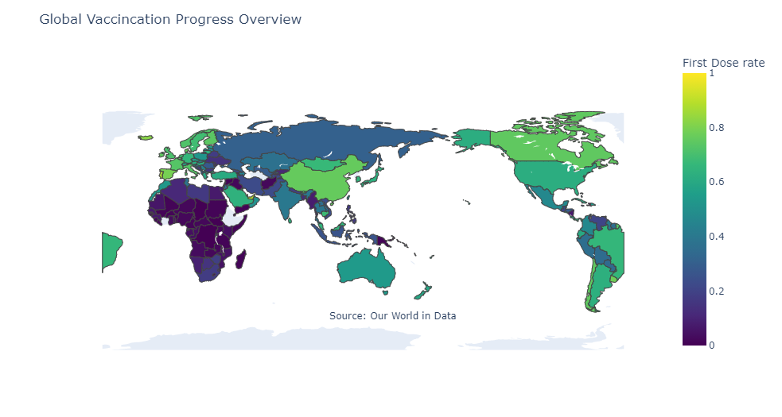
COVID Vaccination Global Progress Overview

Slide 6
43.3% of the world population has received at least one dose of a COVID-19 vaccine.
5.95 billion doses have been administered globally, and 28.87 million are now administered each day.
Only 1.9% of people in low-income countries have received at least one dose. (Why?)—We will find out in a bit!

Slide 7
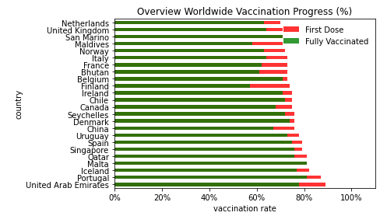

Slide 8
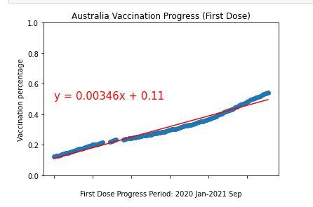

Slide 9
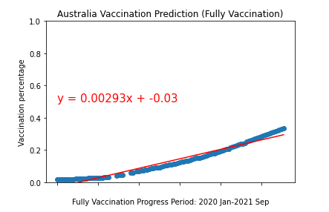

Slide 10
Data Source

